Slide 1
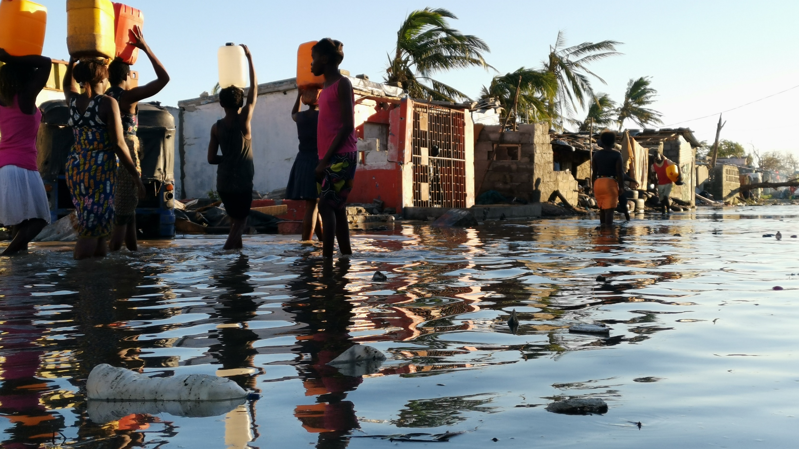


Education
Interrupted
A school year
like no other
The script for this presentation is in the notes box below
Notes:
The last 18 months have been like no other for everyone in the world.
While the COVID-19 pandemic has turned our lives upside down and caused pain and suffering across the world, the climate emergency has continued to disrupt lives and livelihoods on every continent.
In August 2021 the United Nations secretary general declared a climate ‘code red’ for humanity. Tackling climate change is now urgent.
This presentation is about
The disastrous impact of climate change on children and education
How Covid-19 then interrupted education everywhere. More children were suddenly out of school than at any time in recent history.
How governments were not investing enough in education before the pandemic and now need to step up their spending
The three unique opportunities in the UK in 2021 to improve global education
How you and your classmates can help make a difference
PHOTO: Sergio Zimba/Oxfam
Beira, Mozambique, following Cyclone Idai (2019)

Slide 2
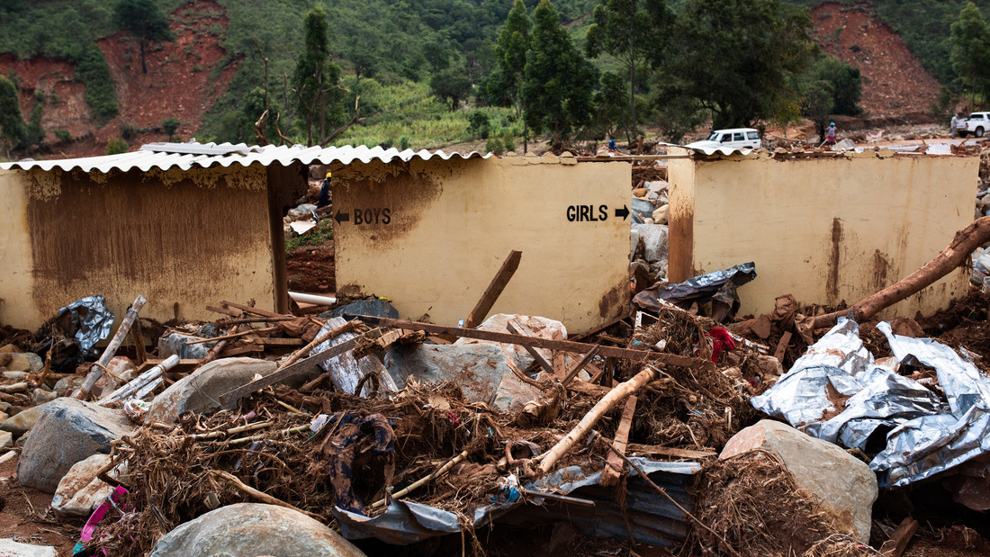
Climate Breakdown
Cyclone Idai – Zimbabwe - 2019
Notes:
Before Covid-19 struck, climate breakdown was already having a disastrous impact on schools and education. It is estimated that 40 million children every year have their educations disrupted by climate-related extreme weather events.
The photo shows the remains of a primary school’s toilets in Zimbabwe. The school buildings were destroyed by landslides following two days of heavy rain brought on by Cyclone Idai in March 2019. Global warming is making storms such as Cyclone Idai more frequent and severe. Schools buildings are rarely built well enough to withstand storms as strong as this, and classrooms are swept away. Other times schools are used as emergency centres and children are sent home. Or there may not be enough water for sanitation, and school stops being safe. All around the world climate breakdown is interrupting education and children are out of school.
PHOTO
Philip Hatcher-Moore/Oxfam (2019)

Slide 3
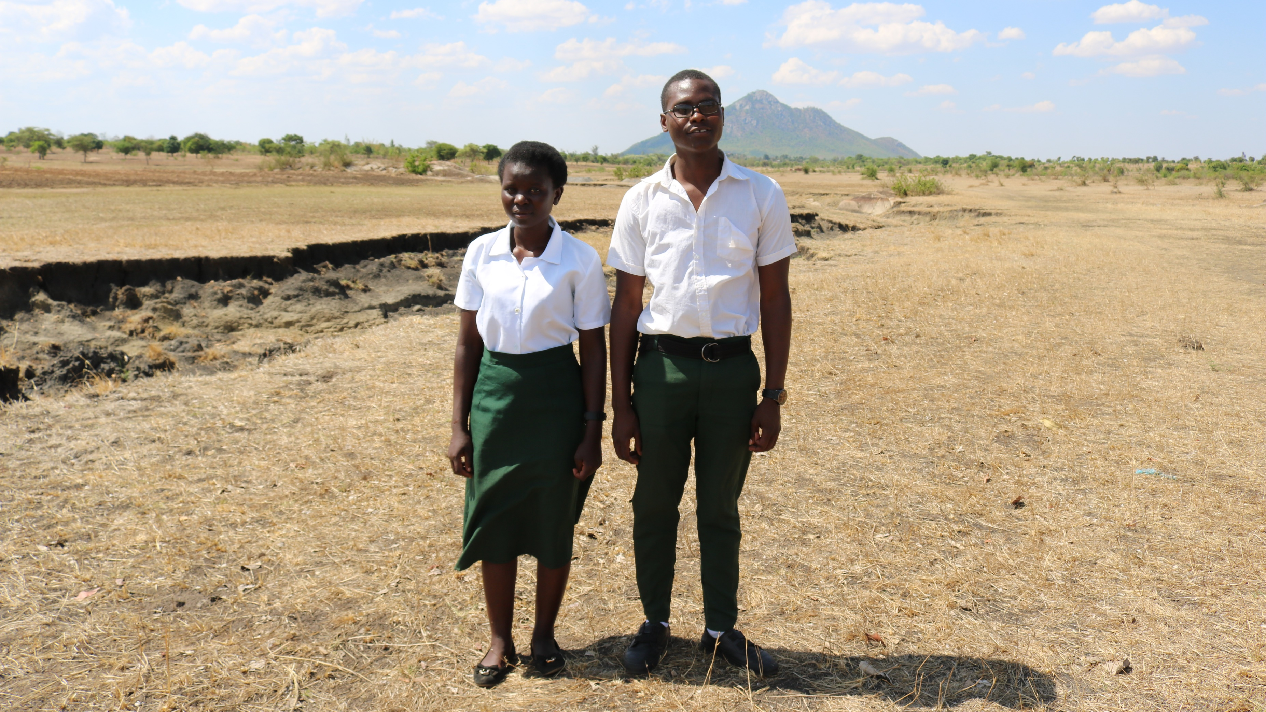
Climate Breakdown
Malawi - 2020
Notes:
Climate breakdown isn’t always a sudden event like a storm. It is often a slow change in weather patterns which makes it impossible for farmers to know when to plant and harvest their crops.
Jessy and Isaac from Malawi were the Send My Friend to School Young Ambassadors in 2019. In this photo, taken at the end of 2020, they are standing in the countryside near their school. This used to be a fertile area. But if you look at the landscape around them now you can now see it is very dry. Jessy and Isaac are standing next to a completely dry river bed. Malawi has been experiencing lengthy droughts and unpredictable rainy seasons linked to climate breakdown. Farmers cannot grow the same yields of crops as before, and when it is as dry as this maize dies in the field. Jessy told us that she missed time off school because her parents didn’t have enough crops to sell to pay her school costs. Isaac told us people used to go fishing in the river, but now it is completely dry.
Climate breakdown is having an indirect but serious effect on education. Children, especially girls, are taken out of school because their parents don’t have enough money to pay their costs and need the children to help at home. And the reason parents don’t have enough money is because climate breakdown reduces their incomes from farming and fishing.
WATCH: Jessy and Isaac’s testimony at the London rally for the Global Climate Strike, September 2019 - https://www.youtube.com/watch?v=EJH054VFIQ4
PHOTO
Watipaso Kaliwo/Oxfam (2020)

Slide 4
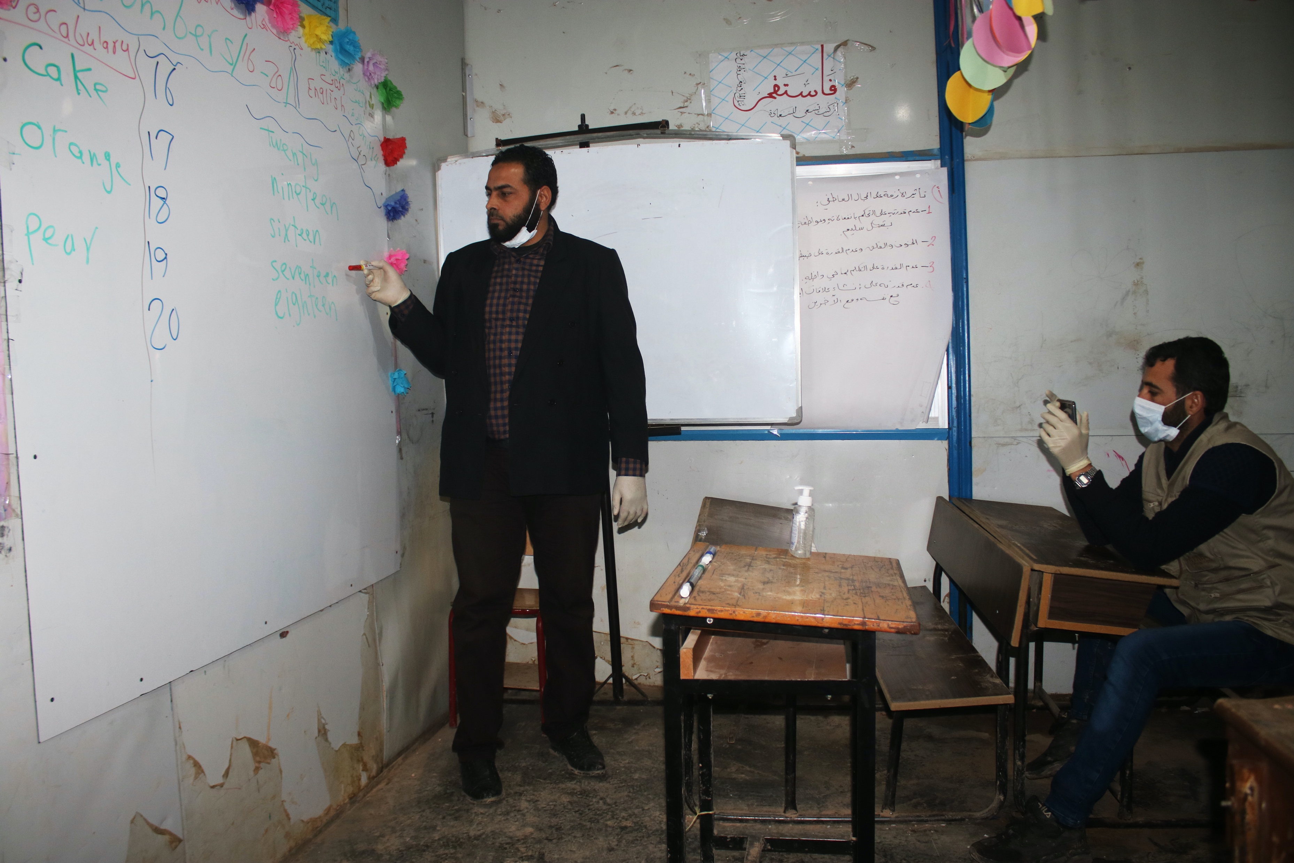
COVID-19
April 2020
8 out of 10 of the world’s children were out of school
Notes:
Then in March 2020 the Covid-19 pandemic forced schools all around the world to close. Within weeks more than 80% of the world’s children were out of school with no idea when or if they would return. Everywhere it’s been the poorest and most disadvantaged children who have been affected the most and the longest by school closures and by climate change.
It is feared that between 10 million and 20 million children may never return to school after the Covid-19 pandemic, wiping out years of progress towards getting all children into school.
The photo shows teachers in Idlib, Syria, filming a virtual lesson on a mobile phone while schools were closed to pupils during the Covid-19 pandemic in 2020.
DATA
Covid-19 school closures visualiser: https://en.unesco.org/covid19/educationresponse
PHOTO
Credit: Save the Children ‘Save Our Education’ Idlib Syria pg 55
Basel, a teacher in Idlib, Syria, holds virtual classes due to school closures.

Slide 5
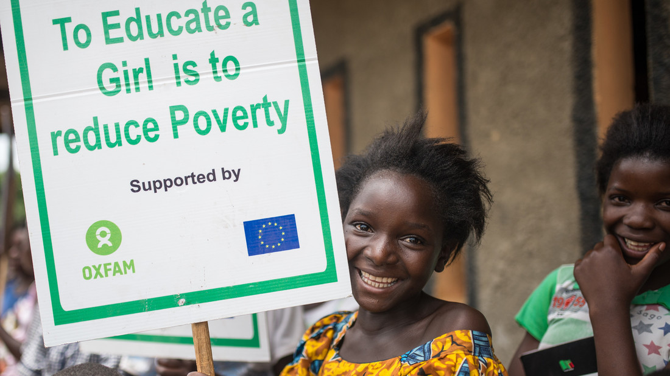
Education is for all
Zambia
Notes:
Back in 2015 the global community promised that every child in the world would receive a quality education by 2030. This is known as Sustainable Development Goal (SDG) 4. However the Covid-19 pandemic and climate breakdown have put this promise off track.
But there’s another problem at the root of why 258 million children were out of school even before the Covid-19 pandemic struck. And the problem is simply that the world as a whole isn’t spending enough on children’s education. In many countries there aren’t enough schools near where children live, there are too few teachers or classes are too large for children to learn well. And when children are missing out on education, it’s usually girls, children with disabilities and children in conflict-affected areas who are the most likely to miss out. It takes extra spending to make sure these groups of children receive a good education.
The photo shows a young campaigner in Zambia calling for greater support for girls education. Every year from Year 6 onwards, more than double the number of girls than boys in Zambia drop out of school.
DATA:
Girls and boys drop out of school in Zambia: https://openknowledge.worldbank.org/bitstream/handle/10986/23865/K8486.pdf?sequence=4&isAllowed=y
Photo: Aurelie Marrier d'Unienville /Oxfam (2018)

Slide 6



1
Glasgow
31 October to 12 November 2021
2
Cornwall
11 – 13 June 2021
3
London
28 - 29 July 2021
Notes:
However the world has three special opportunities during 2021 to save education. All three are taking place in the UK. Two have already happened and the third takes place in October and November
The COP26 (26th Conference of the Parties) is the annual United Nations climate change conference which takes place in a different country every year. In 2021 the COP takes place in Glasgow between 31 October – 12 November with Great Britain chairing the conference. The purpose of the COP is for countries to agree on how to fairly reduce their carbon emissions to ‘net zero’ and how to support lower-income countries that have already been badly affected by climate breakdown. Great Britain and the COP will be called on to include education in their plans to make schools more resilient and sustainable, adapt to climate change and give young people more say in climate decision making.
The G7 (Group of 7) are the world’s seven richest countries. They met in Cornwall between 11-13 June with Great Britain chairing the meeting. The G7 promised to support girls education but only the UK, France and the EU made specific promises about their spending on education.
The GPE (Global Partnership for Education) is a group of countries who pay into a fund which helps education in lower income countries. All of the G7 are members of the GPE. The GPE met in London between July 28-29 with Great Britain and Kenya chairing the meeting. The GPE hoped to raise $5 billion in promises over the next 5 years. However the meeting only raised $4 billion, still a lot of money but $1 billion short of the target
Now that it’s the autumn term, attention is focused on the COP conference and the changes it can make.
In the next slides we’ll look at some of the solutions being proposed. You’ll have the chance to think about and add your own.
MORE INFORMATION:
G7: https://g7-uk.shorthandstories.com/-/index.html
GPE: https://www.globalpartnership.org/
COP26: https://ukcop26.org/

Slide 7
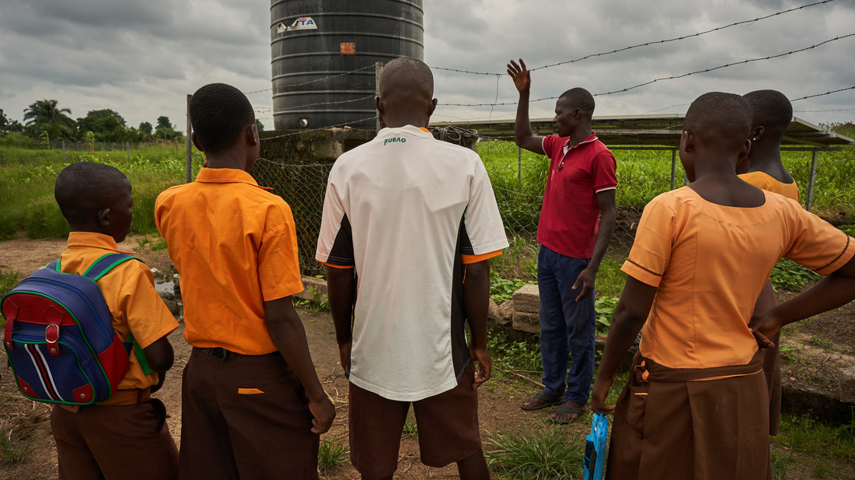
Climate Change Adaptation
Northern Ghana
Lesson at the solar water pump
Notes:
Climate change and education are often not seen as being connected, and the COP26 conference is an excellent opportunity to call on the UK and world leaders to include education and children more clearly in combatting climate change.
These children in northern Ghana are having a lesson at their community’s solar water pump. Just like in Malawi, which we saw earlier, the dry season is becoming longer and the rains are unpredictable. But the pump delivers water from deep underground even when it’s dry. This greatly reduces the time that children, particularly girls, take to collect water, giving them more time for school and study. It also means that families can irrigate their crops and sell them as planned, providing money to pay for their children’s school materials and textbooks. When they learn about the solar pump in their lessons, the children are also learning about how they can help to overcome climate breakdown. The pump isn’t part of the school and it’s owned by the whole community, but it plays an important role in making sure children – especially girls – keep learning.
WATCH:
How the solar pump benefits the entire community and keeps girls learning: https://www.youtube.com/watch?v=-RTzIsfbza0
PHOTO:
Nana Kofi Acquah/Oxfam (2019)

Slide 8
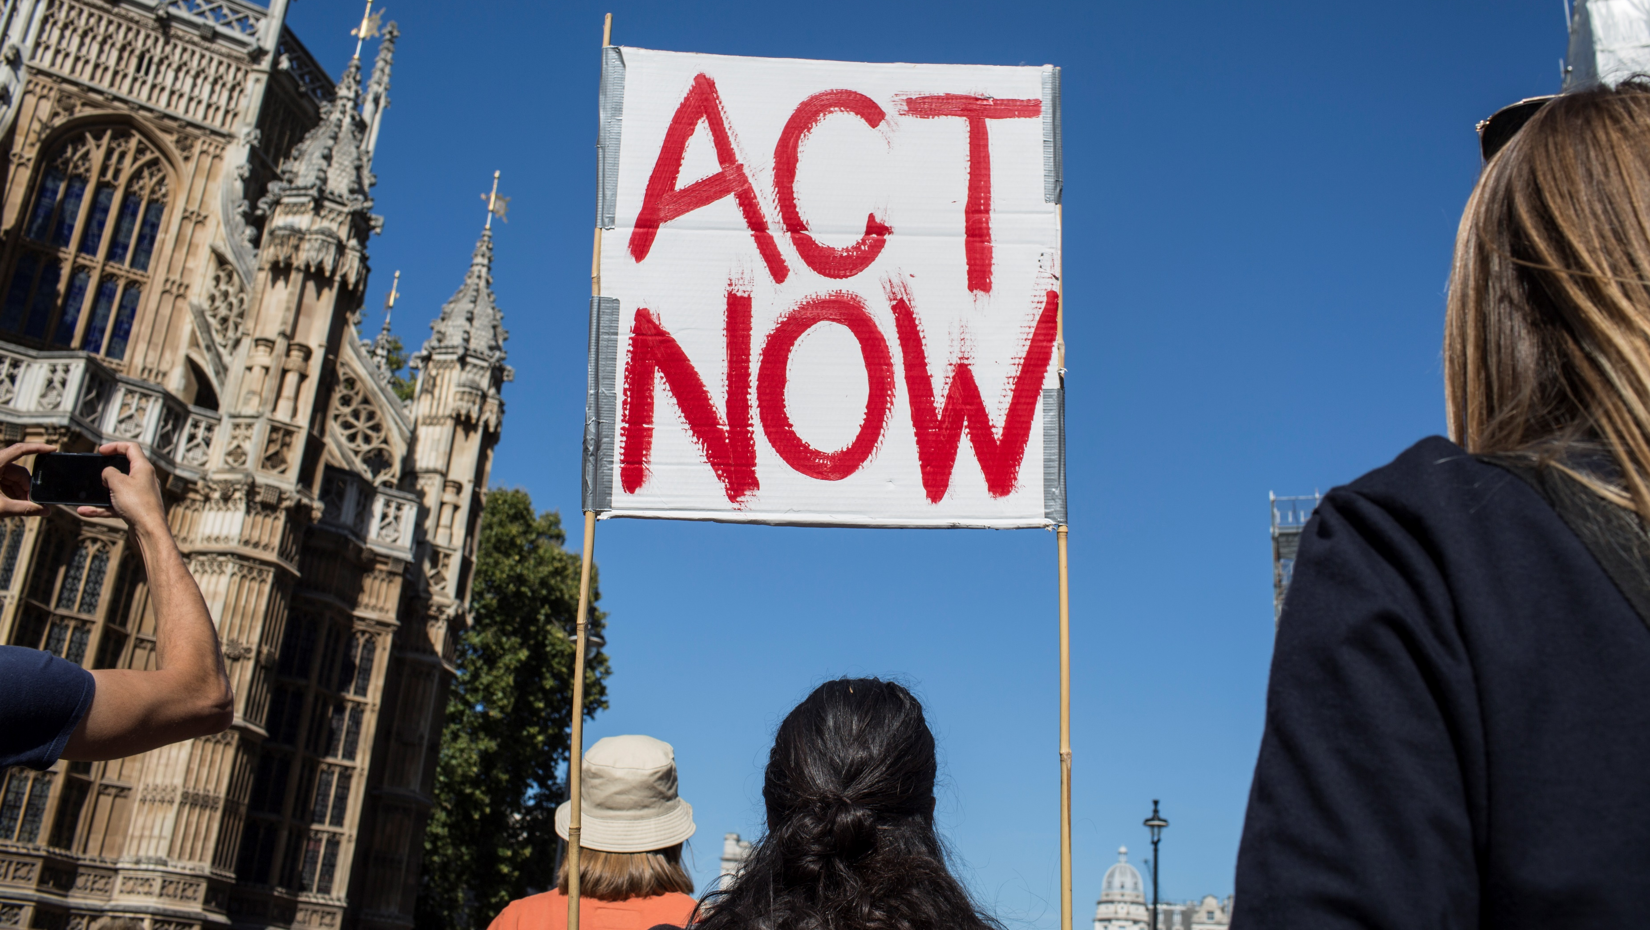
Youth climate rally
Curriculum & Children’s Voice
The UK & everywhere
Notes:
In 2021 the United Nations reported that climate change is irreversible. Countries have to learn how to live with it and reduce its effects as much as possible.
This means that children – wherever in the world they live – should have climate change at the core of their school curriculum. The 21st century and beyond require new skills and knowledge to help us live with the changing climate. Children and young people have historically been left out of the decisions being made about their futures. Now that the climate emergency is at ‘code red’ children – the people who will face its consequences in the future – must have their voices heard.
Up to now improving education and tackling climate change have been mainly viewed as separate and disconnected issues. COP26 provides a major opportunity to change that and bring these issues together
MORE INFORMATION
IPPC 6th Assessment Report - https://www.ipcc.ch/report/ar6/wg1/
BBC (9 August 2021) – IPPC Report is ‘code red for humanity’ - https://www.bbc.co.uk/news/science-environment-58130705
PHOTO
Eleanor Farmer/Oxfam
Youth Climate Rally – London (September 2019)

Slide 9
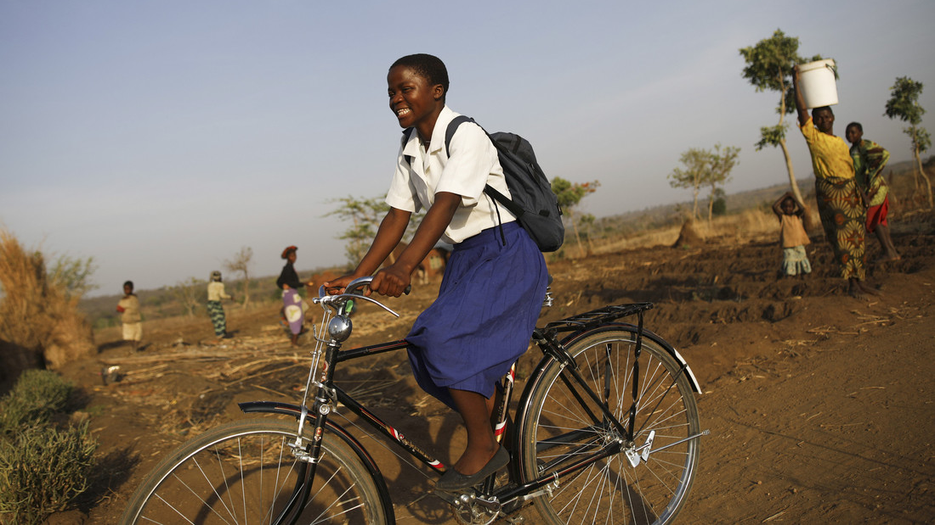
Keep Children Learning
Malawi
Bikes to school
Notes:
While education recovers from Covid-19 and adapts to the climate emergency there still aren’t enough school places, classrooms and teachers for all the children who should be in school. Here in Malawi there is no school near these children’s homes, and it’s a 4 hour round walk every day to get to school. During their long walks to school girls would be vulnerable to harassment from young men, and this led to some girls dropping out of school. The long term solution is to build more new schools which are resilient to the changing climate and teach the skills and knowledge children need, but for the time being some girls have been given bicycles. It means they can get to school faster and quickly pass by the boys on the road who may bother them. It keeps the girls in school and learning
Although the G7 and GPE meetings were disappointing in many respects, they did succeed in stressing the importance of education for all. And if children are to learn to adapt to the changing climate, they must be in school in the first place.
PHOTO:
Corinna Kern/Oxfam (2017)

Slide 10
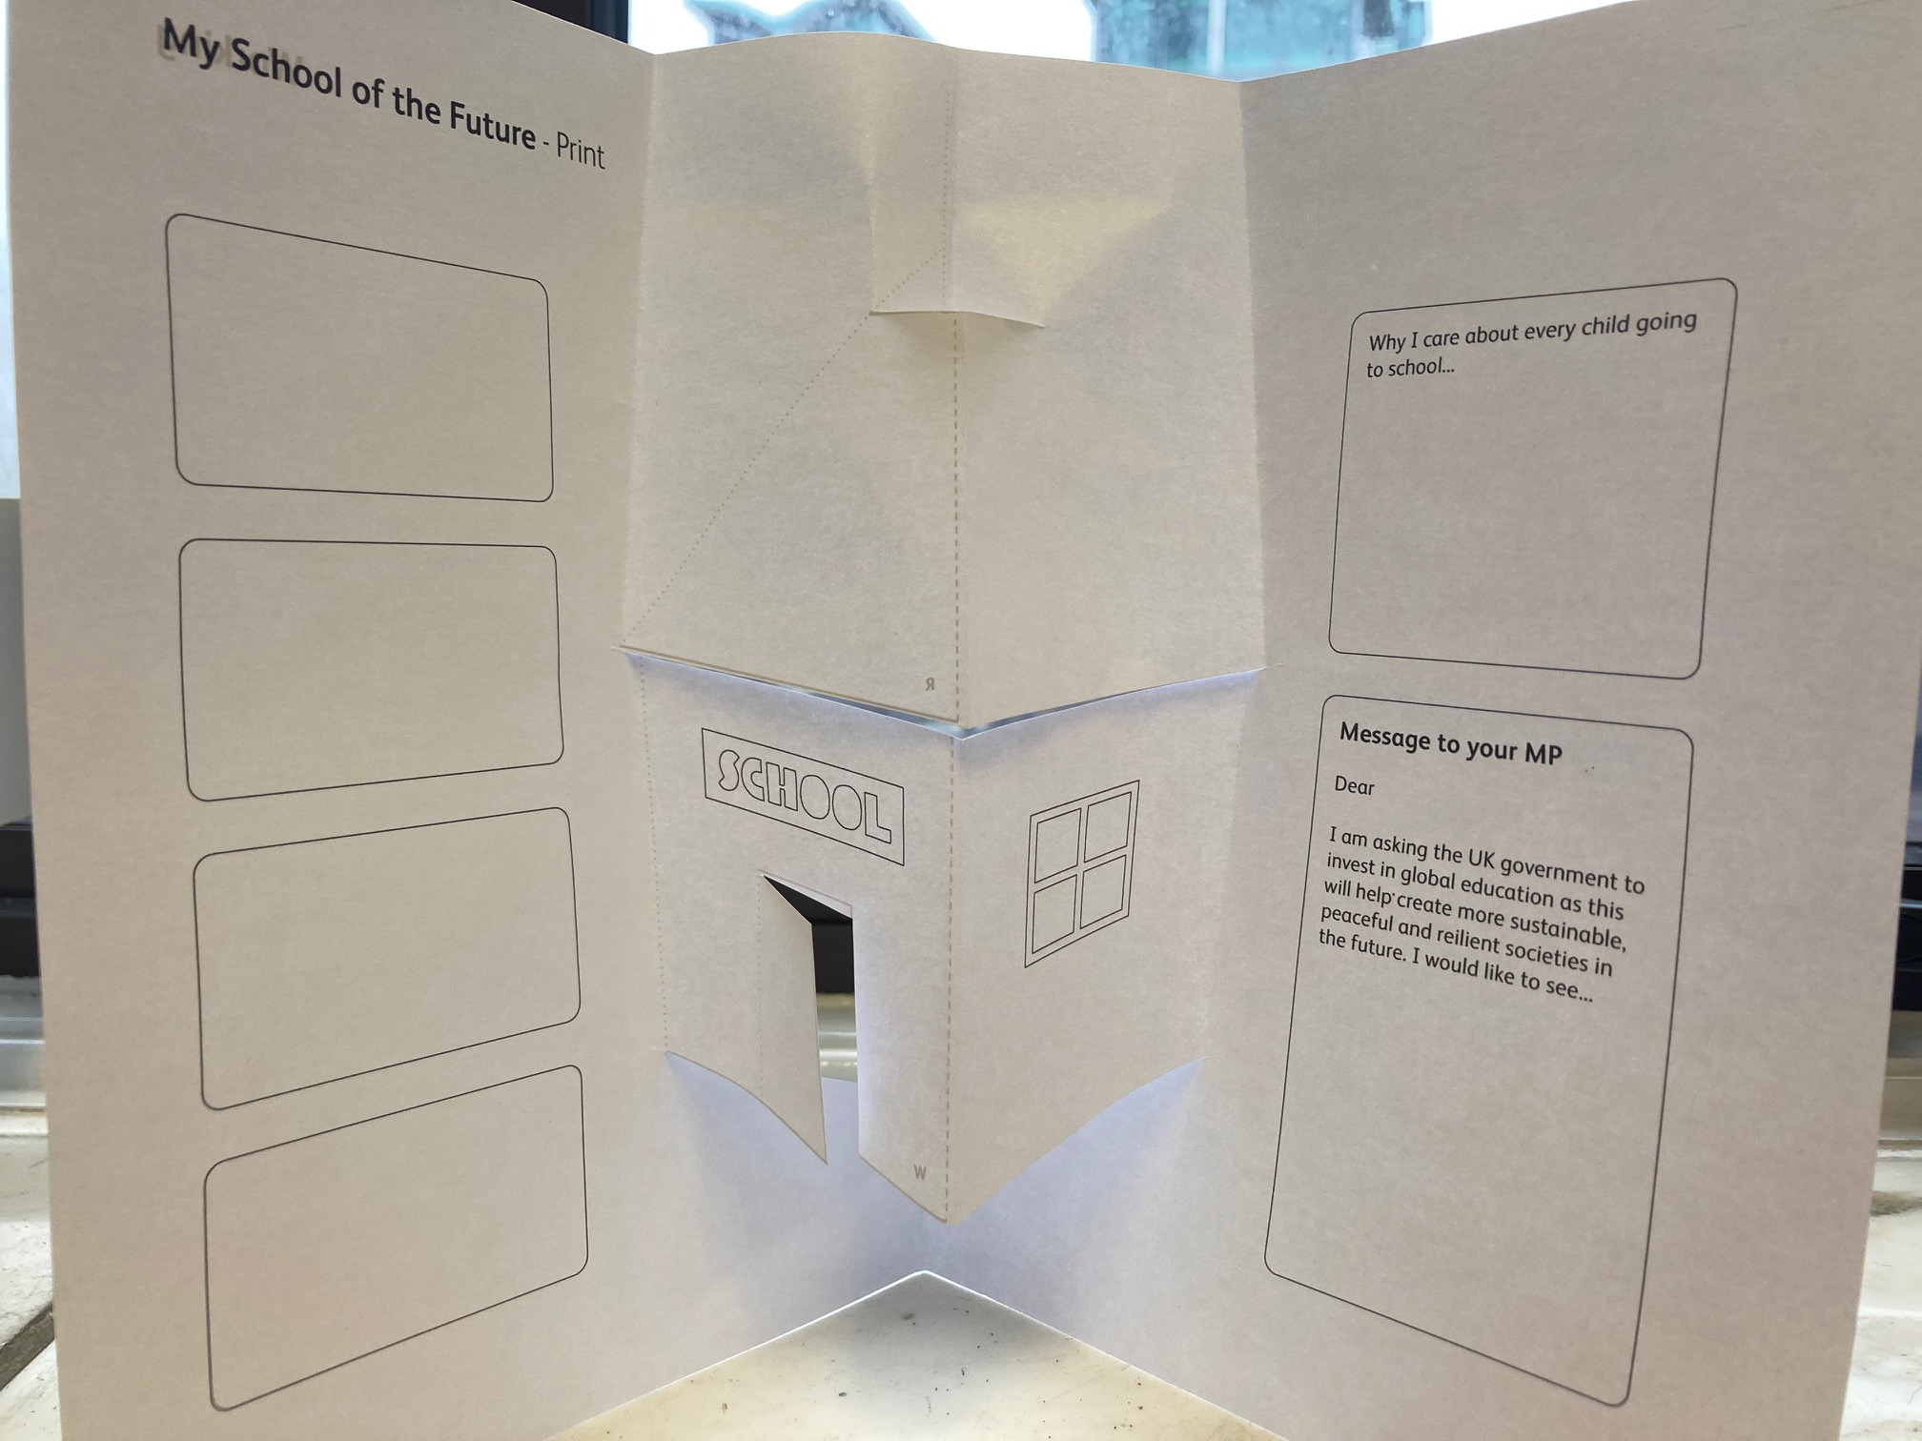
School of the Future
Paper pop –up school of the future
Digital school of the future
Notes:
Education in 2021 faces the 3 challenges of Covid-19 recovery, climate breakdown and a long term lack of investment.
But in 2021 you can have your say in shaping a better future
Young people know more about the importance of school and education than anyone else. So you have a special role in campaigning for every child to go to a resilient and sustainable school where they learn the knowledge and skills for a changing climate
First of all we’d like you to think about the best policies to ask for at the COP26 - and to think up your own ideas. There are some examples in this presentation to get you thinking.
Then we’d like you to design your school of the future, like in this picture, which will be inclusive, resilient and sustainable. You can make your pop up school with paper or design your school online.
Around the side of your school write a message to your MP and the policies you’d like to see governments discuss at the COP26. Then collect these together.

Slide 11
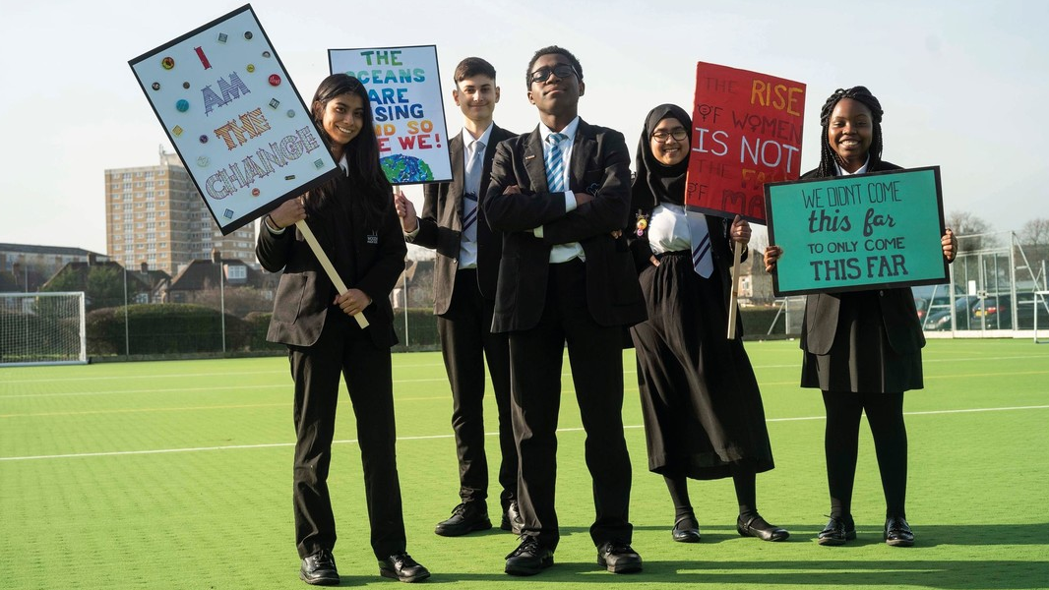
Thank you
Young
Campaigners
Notes:
Collect as many cut-out school messages as you can and send them to your MP. You can do this online or you may post paper copies. However you decide to send your messages, call on your MP to pass them on to to the Prime Minister.
Then aim to meet your MP, either online or in person. Ask your MP to ask the Prime Minister to include education at COP26 and keep prioritising it. Change will only happen if we ask for it.
Young people play a vital part in the global campaigns for climate justice and education
Thank you for taking part
PHOTO:
Taken in London: Kieran Doherty/Oxfam (2020)

